Slide 1
Unit-III Sequence Diagrams

Slide 2
Interaction Diagrams
A series of diagrams describing the dynamic behavior of an object-oriented system.
A set of messages exchanged among a set of objects within a context to accomplish a purpose.
Often used to model the way a use case is realized through a sequence of messages between objects.

Slide 3
Interaction Diagrams
The purpose of Interaction diagrams is to:
Model interactions between objects
Assist in understanding how a system (a use case) actually works
Verify that a use case description can be supported by the existing classes
Identify responsibilities/operations and assign them to classes

Slide 4
Interaction Diagrams (Cont.)
UML
Collaboration Diagrams
Emphasizes structural relations between objects
Sequence Diagram
depicts interaction between objects

Slide 5
Sequence Diagrams
A sequence diagram simply depicts interaction between objects in a sequential order i.e. the order in which these interactions take place
Sequence diagrams describe how and in what order the objects in a system function.

Slide 6
Illustrates how objects interacts with each other.
Emphasizes time ordering of messages.
Can model simple sequential flow, branching, iteration, recursion and concurrency.

Slide 7
Context
Object interaction use in three context
1.Interaction of object in context of system or subsystem
2.Interaction of object in context of operation
3.Interaction of object in context of class

Slide 8
Sequence Diagram Notations –
Actor
Object
Life line
Activation Bar
Message

Slide 9
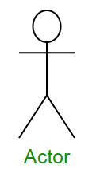
Actors – An actor in a UML diagram represents a type of role where it interacts with the system and its objects.
It is important to note here that an actor is always outside the scope of the system

Slide 10
We use actors to depict various roles including human users and other external subjects.
We represent an actor in a UML diagram using a stick person notation.
We can have multiple actors in a sequence diagram.

Slide 11
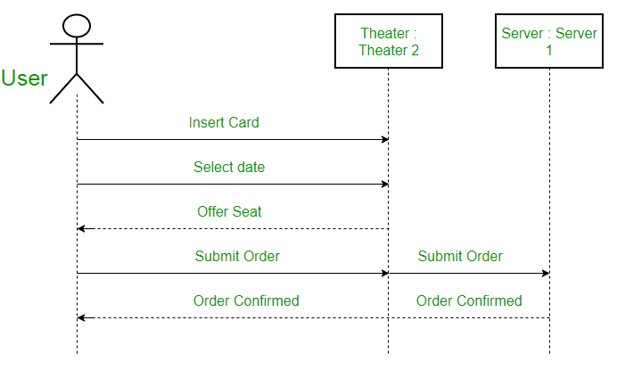

Slide 12
Object
member-object
LibraryMember-class
member:LibraryMember
:LibraryMember

Slide 13
Object
Object naming:
syntax: [instanceName][:className]
Name classes consistently with your class diagram (same classes).
The Life-Line represents the object’s life during the interaction
myBirthdy :Date

Slide 14
Life Line
A lifeline is a named element which depicts an individual participant in a sequence diagram. So basically each instance in a sequence diagram is represented by a lifeline.
Lifeline elements are located at the top in a sequence diagram.
The standard in UML for naming a lifeline follows the following format – Instance Name : Class Name

Slide 15
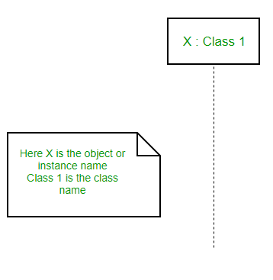

Slide 16
Activation Bar
activation: thick box over object's life line; drawn when object's method is on the stack
either that object is running its code, or it is on the stack waiting for another object's method to finish
nest to indicate recursion

Slide 17
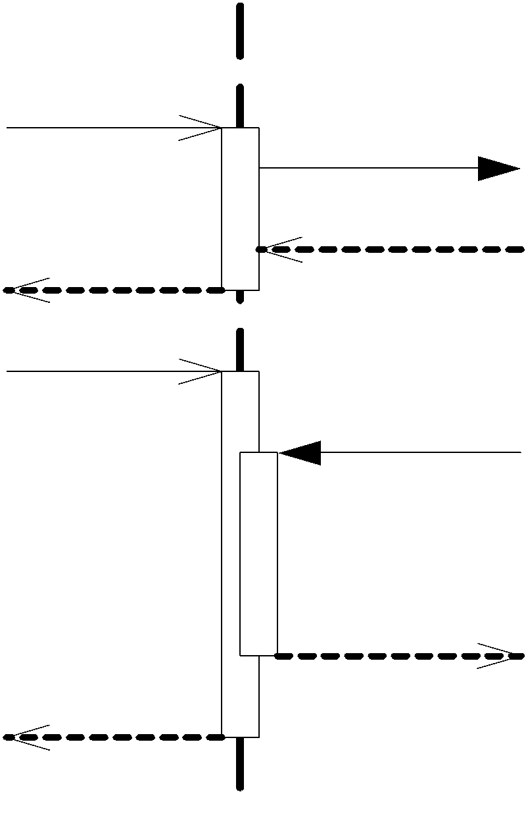
objcet:Class
Activation
Nesting

Slide 18
Activation bar is the box placed on the lifeline. It is used to indicate that an object is active (or instantiated) during an interaction between two objects.
The length of the rectangle indicates the duration of the objects staying active.

Slide 19
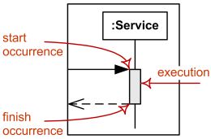

Slide 20
Messages
Messages – Communication between objects is depicted using messages.
The messages appear in a sequential order on the lifeline.
We represent messages using arrows.
Lifelines and messages form the core of a sequence diagram.
A message can flow in any direction; from left to right, right to left or back to the Message Caller itself.

Slide 21
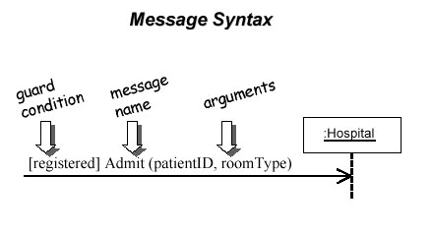
The message arrow comes with a description, which is known as a message signature, on it. The format for this message signature is below. All parts except the message_name are optional.
attribute = message_name (arguments): return_type

Slide 22
Messages Types
Synchronous
Asynchronous
Reply
Create
Destroy
Found
Lost

Slide 23
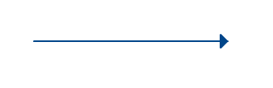
Synchronous messages
A synchronous message waits for a reply before the interaction can move forward.
The sender waits until the receiver has completed the processing of the message
Represented by a solid line with a solid arrowhead.
The caller continues only when it knows that the receiver has processed the previous message i.e. it receives a reply message

Slide 24
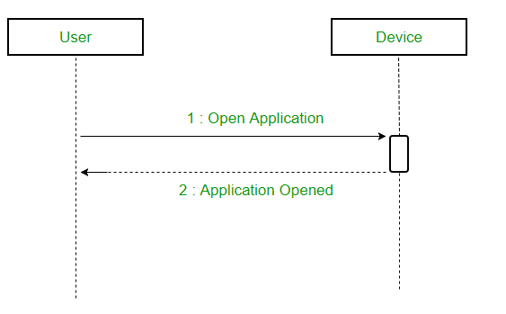

Slide 25
Asynchronous Messages
An asynchronous message does not wait for a reply from the receiver.
The interaction moves forward irrespective of the receiver processing the previous message or not.
use a lined arrow head to represent an asynchronous message.

Slide 26
Reply Message
Reply messages are used to show the message being sent from the receiver to the sender.
We represent a return/reply message using an open arrowhead with a dotted line.
The interaction moves forward only when a reply message is sent by the receiver.

Slide 27
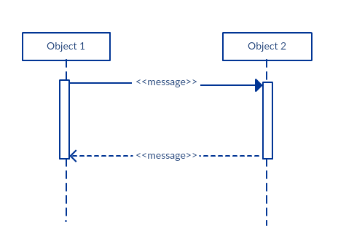

Slide 28
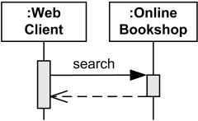

Slide 29
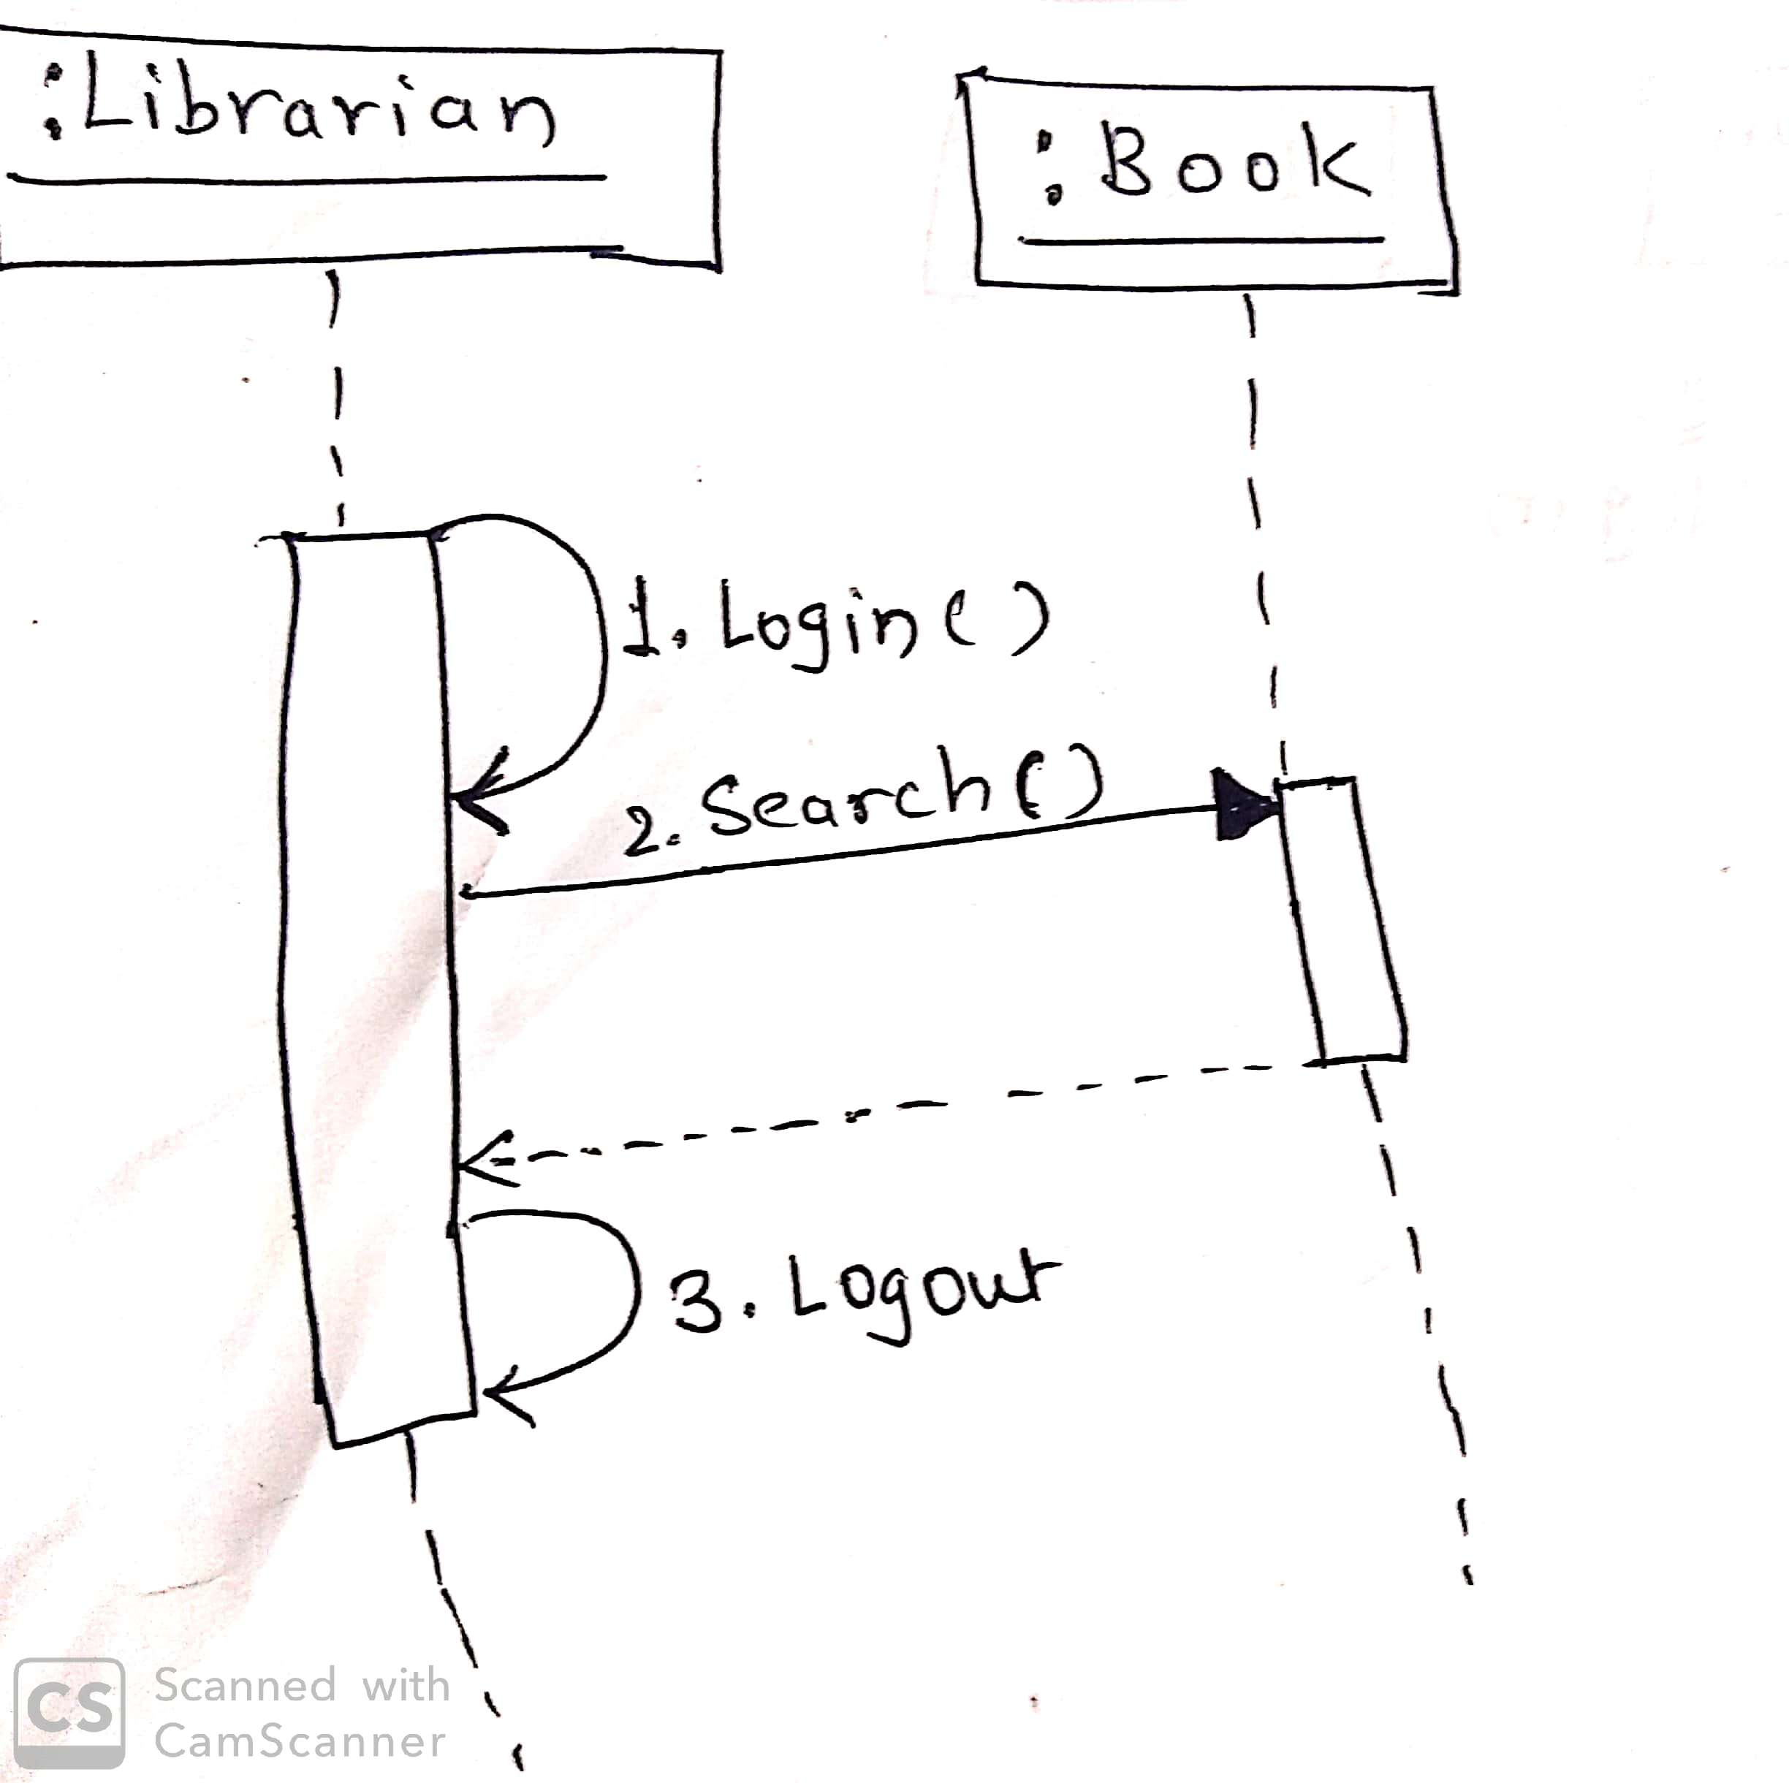
LMS- for search book

Slide 30
Create
We use a Create message to instantiate a new object in the sequence diagram.
There are situations when a particular message call requires the creation of an object.
It is represented with a dotted arrow and create word labeled on it to specify that it is the create Message symbol.

Slide 31
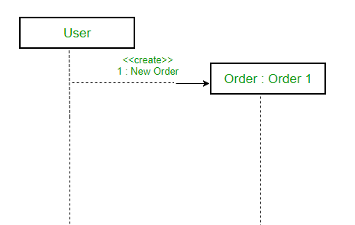
For example – The creation of a new order on a e-commerce website would require a new object of Order class to be created.

Slide 32
Delete Message
We use a Delete Message to delete an object. When an object is dealocated memory or is destroyed within the system we use the Delete Message symbol.
It destroys the occurrence of the object in the system.
It is represented by an arrow terminating with a
X.

Slide 33
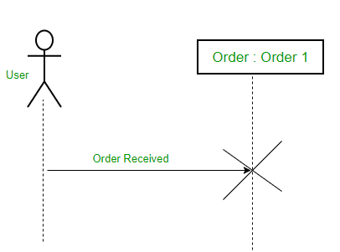
For example – In the scenario below when the order is received by the user, the object of order class can be destroyed.

Slide 34
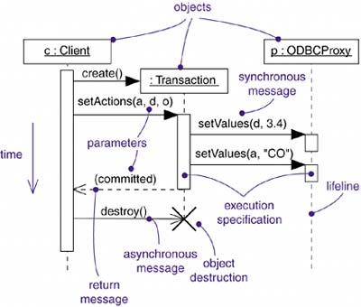

Slide 35
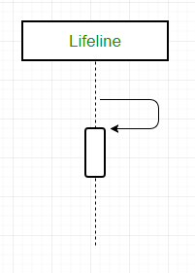
Self Message
Certain scenarios might arise where the object needs to send a message to itself.
Such messages are called Self Messages and are represented with a U shaped arrow.

Slide 36
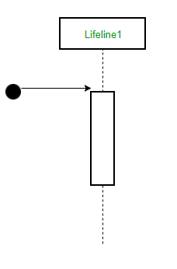
Found Message
Found Message is a message where the receiving event is known, but there is no (known) sending event. It is interpreted as if the origin of the message is outside the scope of the description.
A Found message is used to represent a scenario where an unknown source sends the message.
It is represented using an arrow directed towards a lifeline from an end point.

Slide 37
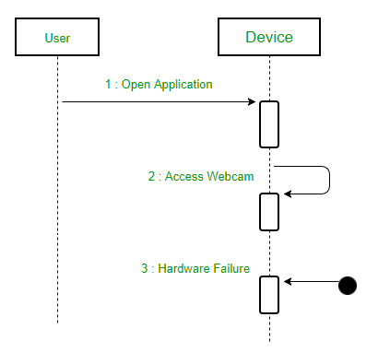
For example: Consider the scenario of a hardware failure.

Slide 38
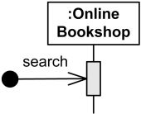

Slide 39
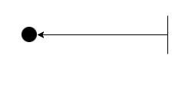
Lost Message
Lost Message is a message where the sending event is known, but there is no receiving event.
It is interpreted as if the message never reached its destination.
A Lost message is used to represent a scenario where the recipient is not known to the system
It is represented using an arrow directed towards an end point from a lifeline.

Slide 40
For example: Consider a scenario where a warning is generated
The warning might be generated for the user or other software/object that the lifeline is interacting with.
Since the destination is not known before hand, we use the Lost Message symbol.

Slide 41
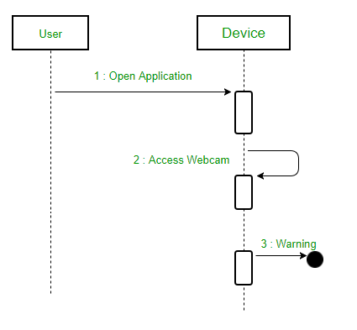

Slide 42
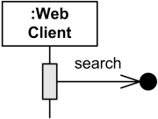

Slide 43
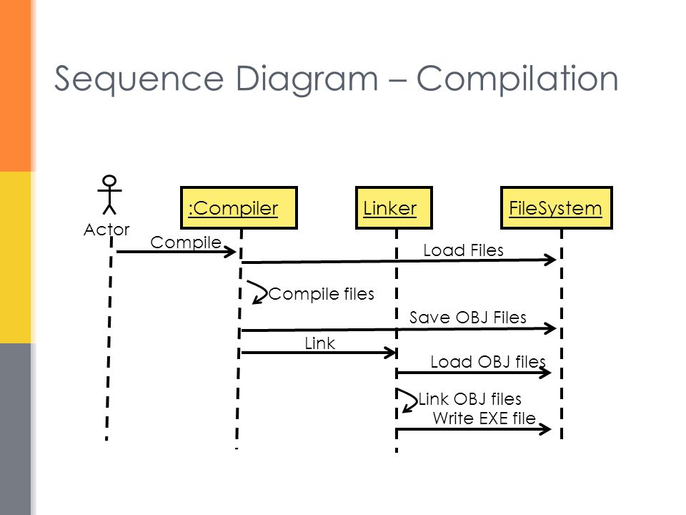

Slide 44
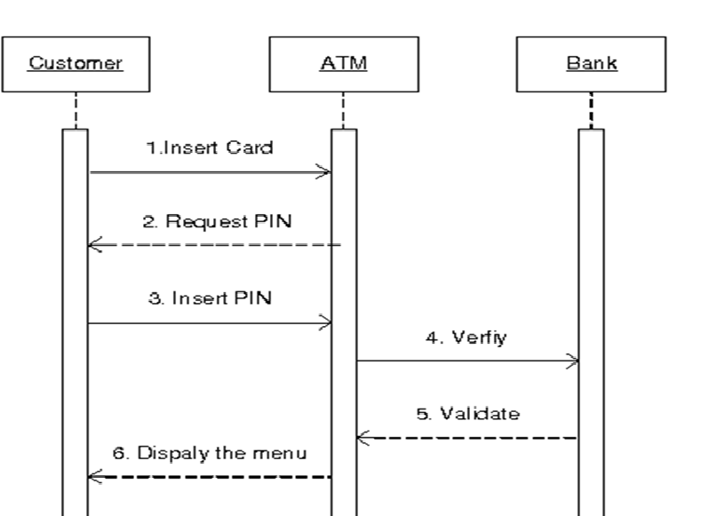

Slide 45
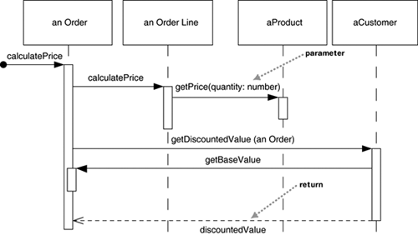

Slide 47
LMS- for issue book-if not available

Slide 48
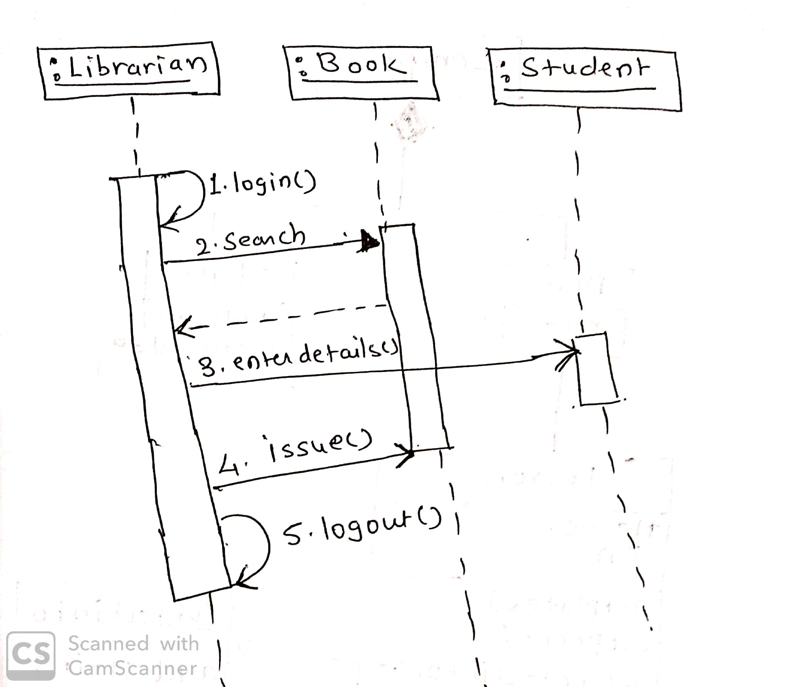
LMS- for issue book-if available

Slide 49
Structured Control in Sequence Diagrams
To show conditionals and loops
To show concurrent execution of multiple sequences
A control operator is shown as a rectangular region within the sequence diagram.
It has a tag a text label inside a small pentagon in the upper left corner to tell what kind of a control operator it is.
The operator applies to the lifelines that cross it. This is considered the body of the operator

Slide 50
Types
Optional execution-opt
Conditional execution-alt
Parallel execution-par
Loop (iterative) execution-loop
Ref-ref

Slide 51
Optional execution
The tag is opt.
The body of the control operator is executed if a guard condition is true when the operator is entered.
The guard condition is a Boolean expression that may appear in square brackets at the top of any one lifeline within the body and may reference attributes of that object.

Slide 52
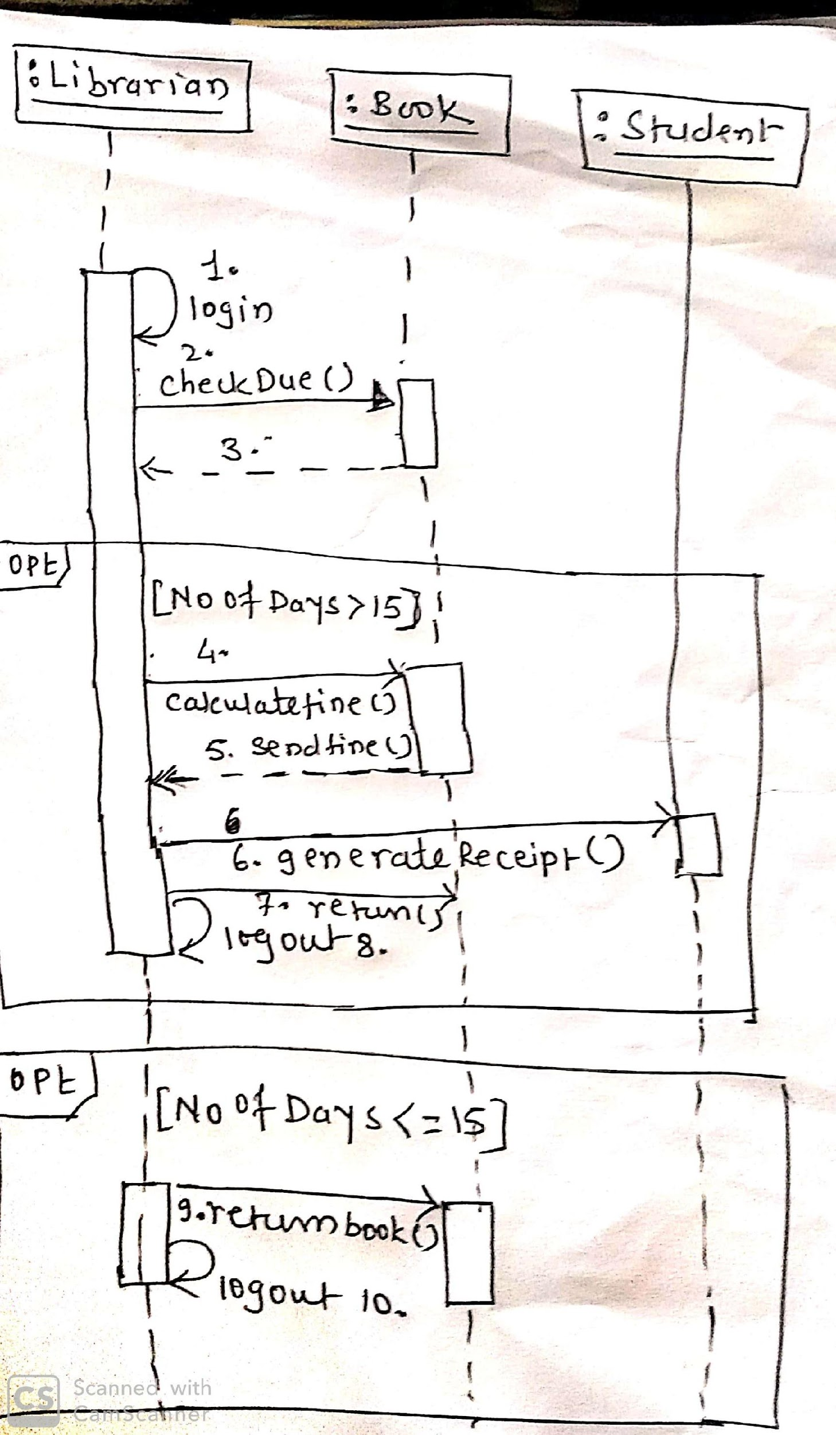

Slide 53
Conditional execution
The tag is alt.
The body of the control operator is divided into multiple sub regions by horizontal dashed lines.
Each sub region represents one branch of a conditional.
Each subregion has a guard condition.
If the guard condition for a subregion is true, the subregion is executed. However, at most one subregion may be executed.
One subregion may have a the special guard condition [else]; this subregion is executed if none of the other guard conditions are true.

Slide 54
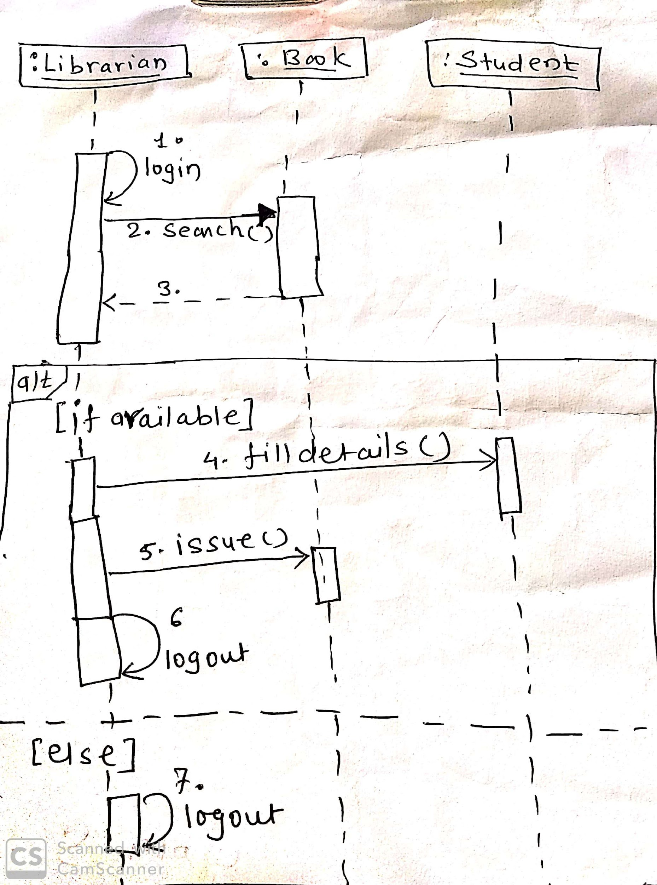

Slide 55
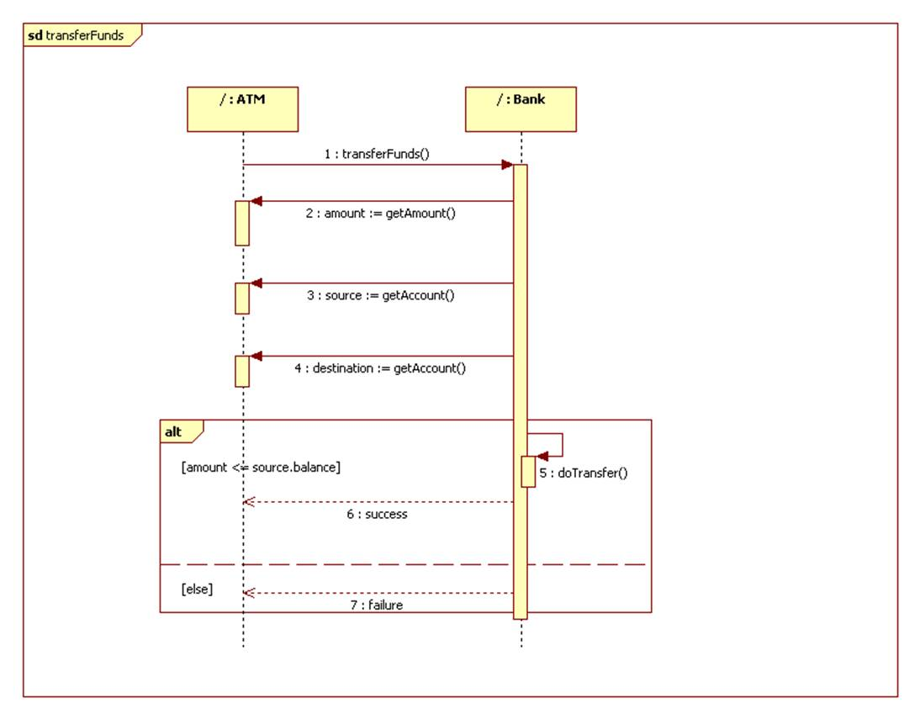

Slide 56
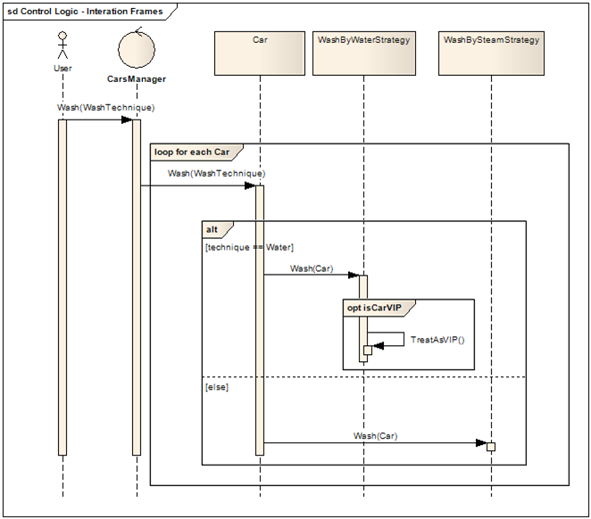

Slide 57
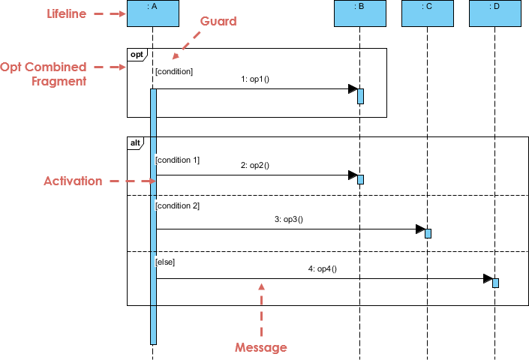

Slide 58
Parallel execution
The tag is par.
The body of the control operator is divided into multiple subregions by horizontal dashed lines.
Each subregion represents a parallel (concurrent) computation.
In most cases, each subregion involves different lifelines. When the control operator is entered, all of the subregions execute concurrently.

Slide 59
Loop (iterative) execution
The tag is loop.
A guard condition appears at the top of one lifeline within the body.
The body of the loop is executed repeatedly as long as the guard condition is true before each iteration.
When the guard condition is false at the top of the body, control passes out of the control operator.

Slide 60
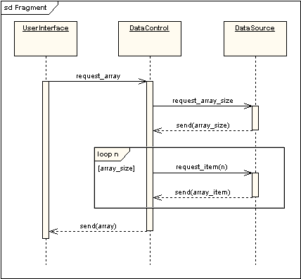

Slide 61
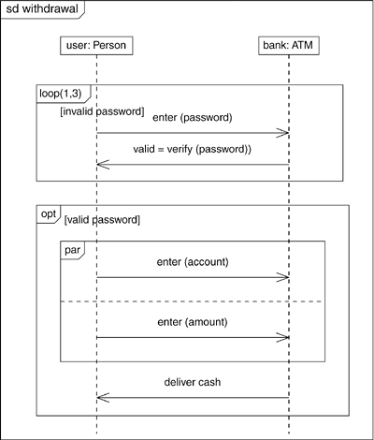

Slide 62
Reference
ref Reference: refers to an interaction defined on another diagram. The frame is drawn to cover the lifelines involved in the interaction.

Slide 63
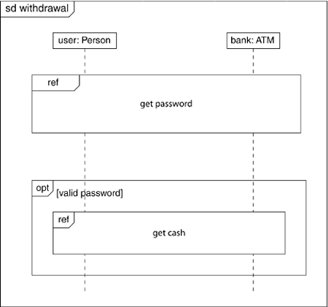

Slide 64
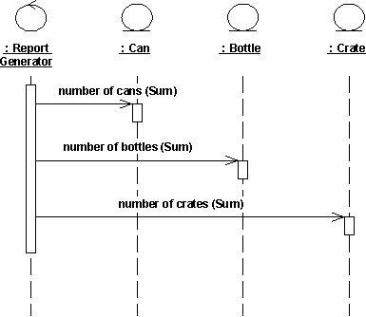

Slide 65
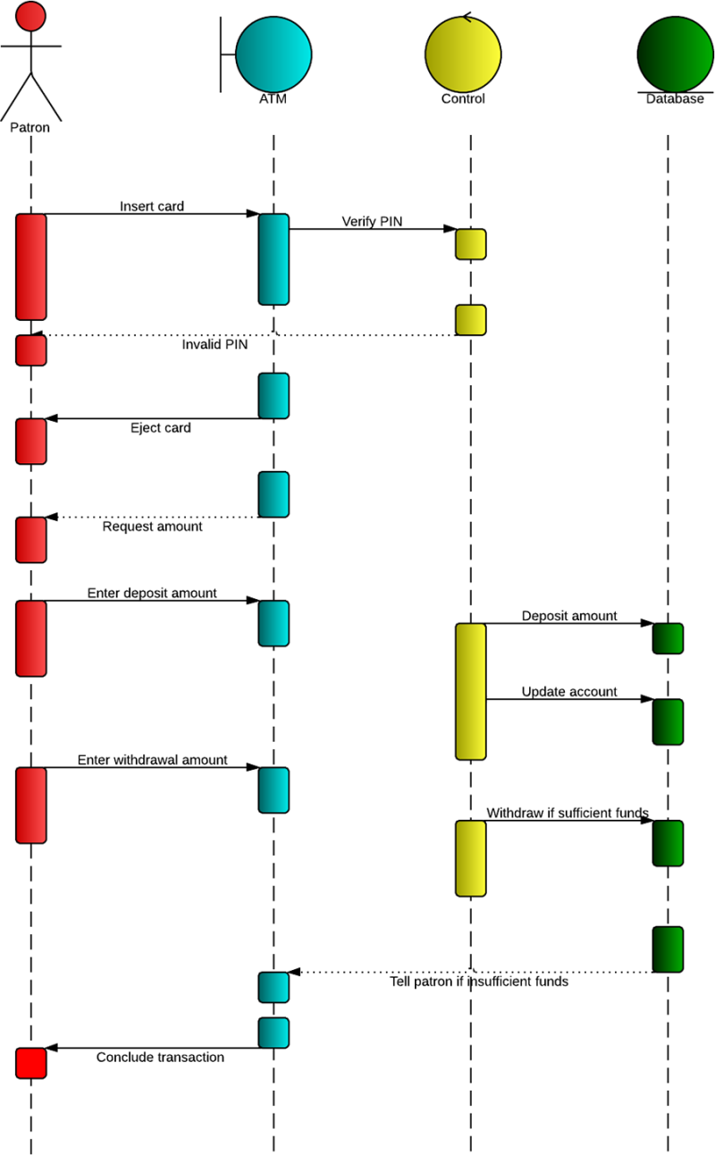

Slide 66
Focus of control (FOC) is used in sequence diagrams to show the period of time during which an object performs an action.
FOC is rendered as a thin, rectangular object that sits on top of object lifelines.
The top of the FOC rectangle coincides with the receipt of a message.

Slide 67
Collaboration Diagram/ communication diagram
Unlike a sequence diagram, a collaboration diagram shows the relationships among the objects.
Sequence diagrams and collaboration diagrams express similar information, but show it in different ways.

Slide 68
Communication Diagrams
A communication diagram emphasizes the organization of the objects that participate in an interaction.
first place the objects that participate in the interaction as the vertices in a graph. Next, render the links that connect these objects as the arcs of this graph.
The links may have rolenames to identify them. Finally, adorn these links with the messages that objects send and receive. This gives the reader a clear visual cue to the flow of control in the context of the structural organization of objects that collaborate.

Slide 69
